Slide 1


Mobisec Unveiled: A Tactical Communication Approach
Luca Calabrese
Marco Marchiante
Alberto Penzo
Dilmurod R. Rakhmatov
Gabriel Rovesti

Slide 2
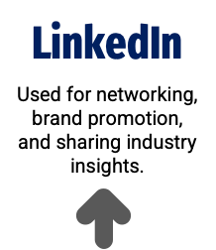

Overview
Critical strength points
Fine-grained analysis
Communication Narrative
Target Audience
Budget Allocation
Communication Channels
Future goals and Discussion Thoughts

Slide 3
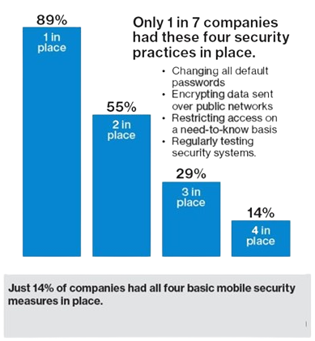




Mobisec: How winners play it better
Brand Awareness
Engaging Narrative
Unique Products
Training & Projects
1 - https://www.forbes.com/sites/louiscolumbus/2018/04/08/83-of-enterprises-are-complacent-about-mobile-security/

Slide 4




Mobisec: Goals
Messages
Result
Knowledge
Visibility
Transmit reliability and knowledge
Increase the visibility of the company
Presence
Reference
Transmit a sense of continuous presence for customers
Become a reference for customers

Slide 5
Audience Analysis
Customers
Audience
Mobisec UEM
Cybersecurity training
Decision-making power
Risk profiles awareness
Mid-Large Corporation
Daily PC usage
Network administrators
CTOs
IT Managers
Information Security Offices
IOT Management
Mobile App Development
Startups
Rapid growth

Slide 6
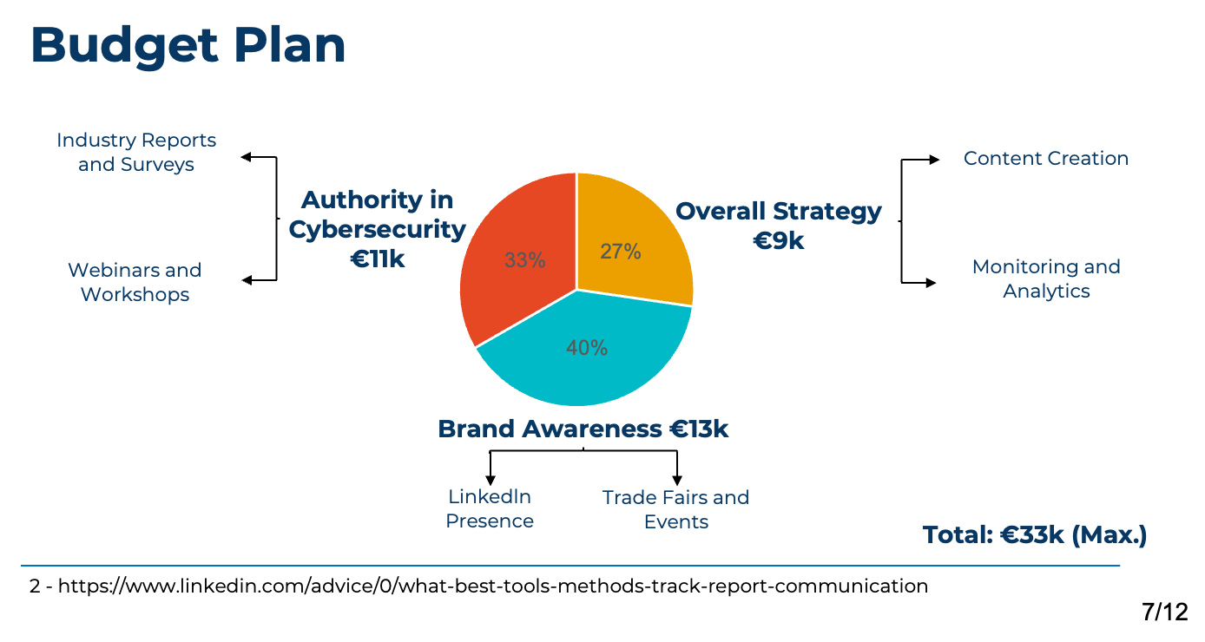

Slide 7
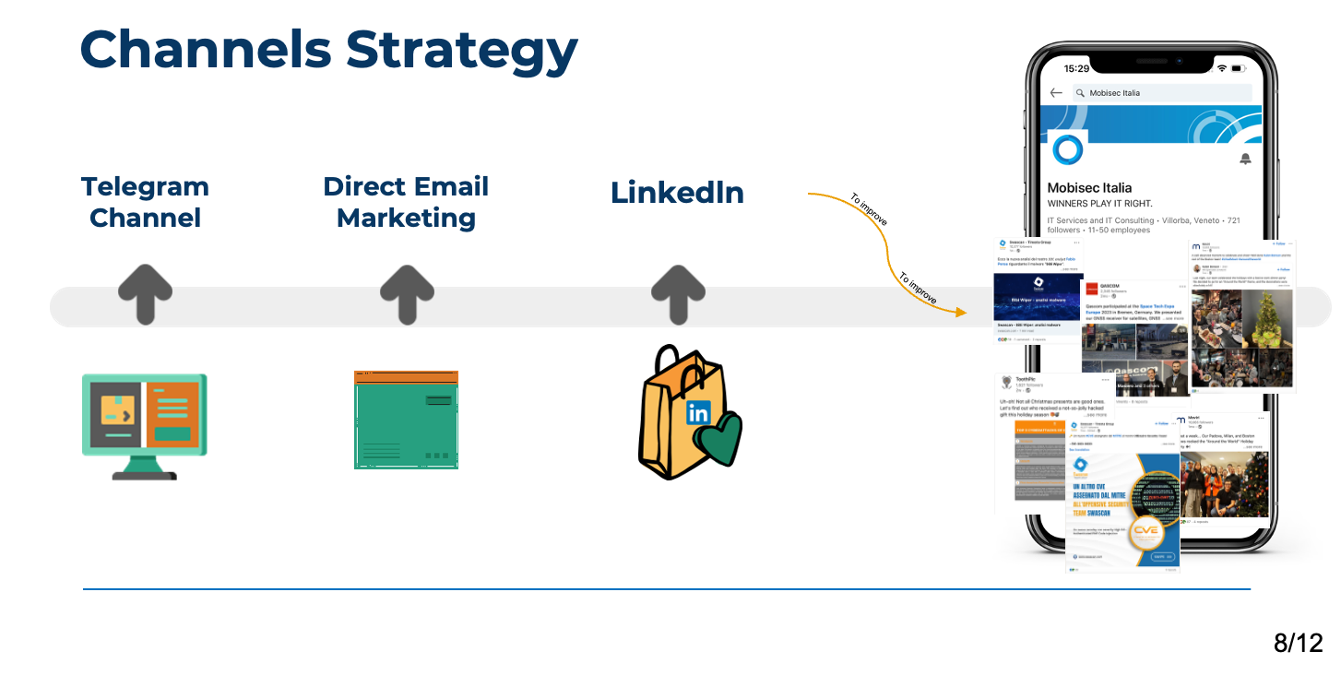

Slide 8
Strategies for Effective Marketing
How do we hook and retain new customers?
Build a compelling messaging plan
Consistency: ensuring consistency across channels reinforces the brand and helps to build trust
Frequency: helps in reinforcing key messages and with brand exposure
Engagement: build brand awareness and contributes to relationship building
Educational tone: educating the audience about the importance of mobile security and the unique benefits of Mobisec’s product
Testimonials: help to build trust and credibility
Call to actions: it encourages further exploration and interaction
3 - https://www.linkedin.com/pulse/power-consistency-creating-cohesive-brand-experience-csstudio-ae/

Slide 9
Application of Branding Strategies
LinkedIn
Mobisec website
Webinars
Employee engagement
Showcasing products and services
Event participation announcements
Blog/Insights section
Customers success stories
Innovative product demos
SEO optimization for better search engine visibility
Online courses on comprehensive mobile security topics
Client engagement through Q&A sessions
4 - https://www.ambitiouspr.co.uk/leveraging-narrative-communication/

Slide 10

Future advice
Accessible
Helping in technical knowledge acquisition by companies and individuals alike
Create products descriptions with explanations for people not in the field
Create pages dedicated to introducing people from outside the industry

Slide 11
Thanks for your attention!

